Slide 1
Dell Desktop PC Supply Chain:
Case Study
Optimizing the Flexibility of the Desktop PC Supply Chain

Slide 2
Background
Dell
  Founded by Michael Dell in 1984 in TX
  Dell direct model
  Strategic relationships with many of the CMs
    Produce semi-completed products and ship to Dell’s US and Ireland factories
  Low-cost and responsiveness
    Suppliers maintain semi-completed goods inventory near Dell’s manufacturing facilities.

Slide 3
Background
Foxconn (Hon Hai Precision)
  Founded in 1974 by Tai-ming Terry Gou in Taiwan
  Originally a maker of plastic parts, connectors and cables, now making a variety of high-tech products, including electrical and mechanical components, modules and sub-systems for PC, consumer electronics and networking.

Slide 4
Background
Foxconn’s strategies
  Develop strategic relationship with industry leaders
    HP、DELL、SONY、NOKIA、MOTOROLA、APPLE、CISCO、IBM
  Predict market trends accurately and introduce new products ahead of its competitors
  Expansion of production capacity for EOS
  Vertical integration to exercise better control over the product quality

Slide 5
Background
CMMS (component, modules, moves, and services)
  Total package solutions from one source
  Generating loyalty and reliance from its clients.
    Buy again
    Buy more
    Tell others to buy

Slide 6
目前，富士康在大陆已拥有100多万名工人。
富士康郑州园区员工已超过30万(2013.12.08)
  2013年前三季度，富士康在河南的下辖企业进出口达209.4亿美元，占全省进出口总值的54.1%，对全省外贸增长的贡献率达85%。
富士康集团将在贵阳高新区设立“先期科技示范工厂”。郭台铭表示：“在贵州预计实现5万人的就业目标，充分利用贵州丰富的劳动力资源。”
富士康大陆的厂区总面积，相当于六大房地产商建筑面积总和的1.5倍以上，相当于125座紫禁城。

Slide 7
Background
Dell and Foxconn’s shared strategy
  To maintain a minimum level of inventory while balancing it with a continuity of supply.

Slide 8
Questions
What is the Problem in Dell case?
What are the effect of the problem?

Slide 9
Problem
  This strategy is disrupted by a continuous shortage of chipset supply from Dell’s chipset manufacturer

Slide 10
Effect of problem
  Not to be able to manufacture the motherboards in China (Level 6)
    Some chassis are shipped empty by ocean first, and motherboards are air-freighted later.
    This leads Dell to utilize Third-Party Integrators (3PI) in the US to do this job.
      Manufacturing costs rising

Slide 11
The goal of this case
  Create a framework for improving the flexibility of the Desktop PC supply chain.
  The framework can answer related questions
    How the various players contribute to the supply chain
    How Dell can work with its suppliers and other strategic partners to more effectively balance demand and supply.

Slide 12
Background
What are the Reasons of choosing CM by OEM

Slide 13
Reasons of choosing CM by OEM
Capability
  OEM may not have the ability to make the item or easily acquire such a capability and must seek a supplier.
Manufacturing competitiveness
  The supplier may have a lower cost, faster availability, etc.
Technology
Therefore, almost all the desktop PCs in the US were initially produced by contract manufacturers in China, except Dell to some extent.
  Why not Dell?

Slide 14
Why not Dell?
For Dell’s business philosophy: Customization
  Finished product made in China unacceptable
  Ocean shipping unacceptable
  Air freighting too cost-prohibitive for heavy and bulky body.
  Therefore, half-assembled in China is a good idea.

Slide 15
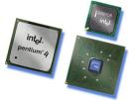
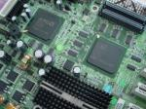
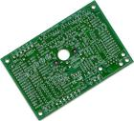

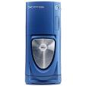

Critical Components of a Desktop PC & Major Component Manufacturers
Chipset
AMD
Intel
Motherboard
ASUS
Foxconn
Intel
MiTAC
Printed Circuit Board
BTI Electronics
Compeq
GCE
Plato Electronic
Desktop PC
Acer
Apple
Dell
Fujitsu Siemens
Gateway
HP
Lenovo/IBM
Desktop Chassis
ASUS
Flextronics
Foxconn
MiTAC
Lite-On
LAN Chip
Broadcom
Intel

Slide 16
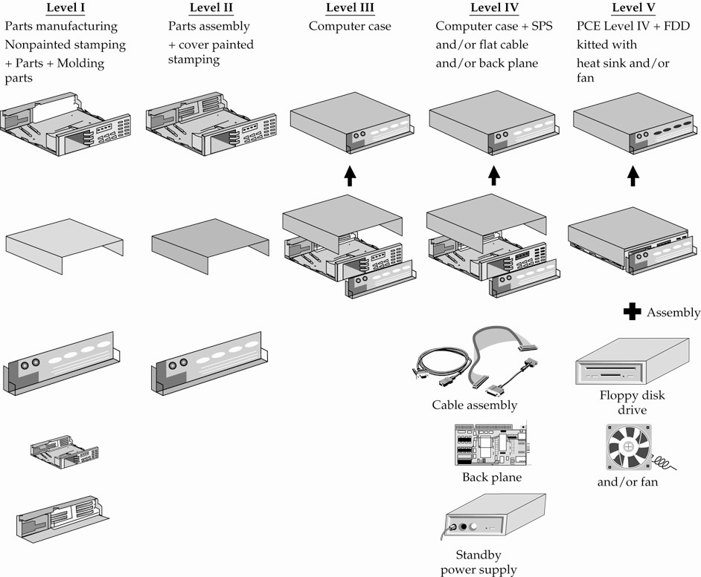
Level 1-5 of desktop PC assembly

Slide 17
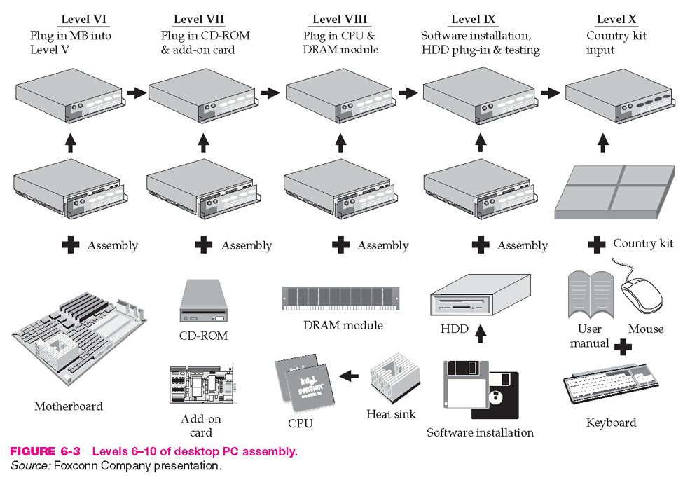
Level 6-10 of desktop PC assembly

Slide 18
Level 11 of desktop PC assembly
Level ( XI )
Packed Monitor with
PC System and Deliver
( Packed in )
Monitor

Slide 19
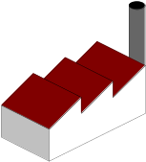

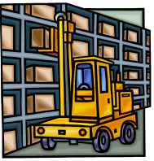

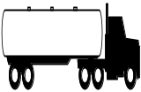

L6 vs. L5
L6
MB
5 Weeks
China Integration
Dell
Manufacturing
Customer
Supplier Logistics Center
Chassis
L5
3rd Party Integrator
MB
: L5 additional cost
1 Week
Dell
Manufacturing
Chassis
Supplier Logistics Center
Customer
5 Weeks

Slide 20
Some of Dell’s products, such as laptops and printers, are manufactured to Level 10 by the CMs, and then ship to Dell’s merge centers.
For desktop, CMs make only Level 5 or 6.

Slide 21
L6 vs. L5
What are The drawbacks and benefits of L5?

Slide 22
L6 vs. L5
Drawbacks
  Air freight cost
  Additional processing cost
  Idle labor for CM
Benefits
  the inventory cost of motherboard is lower
    Motherboards manufacturing can be postponed and allowed JIT production
    Less depreciating cost

Slide 23
Problem Statement
Since July 2004, Dell and its contract manufacturers (CMs) have had to adapt an increasing % of L5 manufacturing:
  Empty chassis are shipped by ocean (L5) to Dell US & Europe first. Motherboards are then air-freighted to Dell US & Europe.
  Dell incurs motherboard expedite/air-freight cost and 3rd-party integration cost.
  CMs incur cost for idle labor dedicated for MB-chassis integration.

Slide 24
L6 vs. L5: Value Comparison
L6
Integrated offshore & outside a Dell facility
Integrated motherboard-chassis shipped on water
Labor savings
MB air-freighting costs are eliminated
Reduced motherboard packaging costs
Reduced supply chain flexibility (inventory cost)
L5
Integrated in US
Chassis shipped on water
Motherboards shipped by air
Increased supply chain flexibility
Increased motherboard air-freighting costs
3rd-party integration cost in US
L6 is more cost-effective than L5.

Slide 25
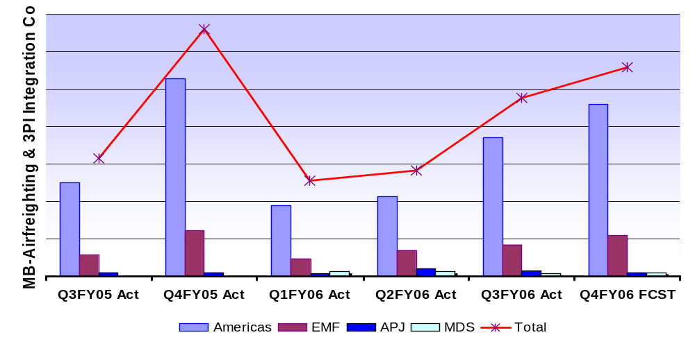
L5 Driving Increasing Operational Cost
Costs of air-freighting MBs and 3PI integration have been increasing.
Worldwide Procurement Expedite Council established to control skyrocketing cost
AMF includes 3PI integration cost. EMF and APJ don’t as integration is done in Dell factory.

Slide 26
Function of expedite council (from paper)
Before the formation of the expedite council
  much freedom to expedite motherboards whenever they felt necessary without having to follow through an approval process.
After the formation
  Requiring any expedite cost to be reviewed and approved by the council first before expediting.

Slide 27
L6 vs. L5 Shipments: % Comparison
L5 shipped % has been increasing since March 2005.
Dell Worldwide L5 vs. L6 Shipments Received
from a Typical Contract Manufacturer
L5%
L6%
100%
7%
6%
5%
4%
6%
4%
11%
14%
9%
10%
15%
90%
27%
80%
70%
60%
50%
93%
94%
95%
96%
94%
96%
89%
86%
91%
90%
85%
40%
73%
30%
20%
10%
0%
Jul-04
Aug-04
Sep-04
Oct-04
Nov-04
Dec-04
Jan-05
Feb-05
Mar-05
Apr-05
May-05
Jun-05

Slide 28
What are the root causes of L5 rising?

Slide 29
Root Causes Analysis (from paper)
Methodology
  Interview with staffs from Dell and Foxconn
  Date analysis (most from expedite council)
    Date of the expedite request
    Name of the requestor
    Type of items required
    Quality of each item required
    Date when the request was reviewed and approved
    Dollar amount required

Slide 30
Root Causes Analysis
Root causes can be broken into four categories
  Chipset supplier decommit or supply issues
    It accounts for 60% of L5 manufacturing
  Quality/engineering issues
    A new supply will be needed
  Dell forecast accuracy
    Actual demand may surpass the forecast
  New production introduction
    More growth during introduction phase

Slide 31
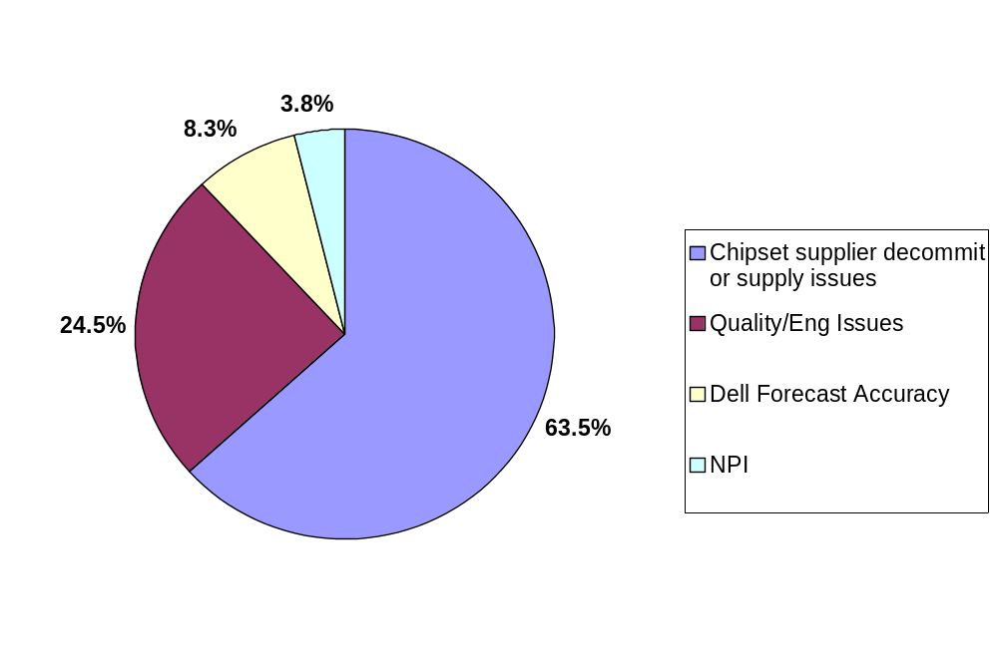
Root Causes Analysis
It’s not absolute measures, but relative weights of these root causes.
AMF Expedite $ by Root Cause (January to June ’05)

Slide 32
Approach on reducing cost
Two major costs associated with L5 are:
Motherboard air freighting cost from China to the US
Motherboard-chassis integration labor cost in the US.
The first cost was entirely dependent on the availability of Intel’s chipsets, which was not in Dell’s direct control in the short run.
However, Dell would have a greater control over its motherboard-chassis assembly cost in the US.

Slide 33
Approach on reducing cost: BPI project team
BPI (Business Process Improvement) project team established to evaluate the following 6 scenarios:
1. Keep as current: 3rd-Party Integrator (3PI) managed by the contract Manufacturers
2. DAO (Dell America Operation) Cellular Integration: Enable the Dell factory work cells to perform L5→L10 mfg work

Slide 34
3、4.Offline Integration: Keep the current L6→L10 manufacturing process unchanged; add a separate facility to handle MB-chassis integration work
  At SLC (Supplier Logistics Center)
  At a Dell-leased building
5. 3PI managed directly by Dell
6. L6 from Equipment Manufacturers’ Mexico plants

Slide 35
Factors to Considered
For each of the 6 scenarios, BPI project team assessed the attributes of complexity and cost
Project Goal:
Identify the optimal scenario
based on these input attributes.

Slide 36
Quantification method
Survey of the various departments at Dell to quantify the difficulty of managing each of the six manufacturing options.

Slide 37
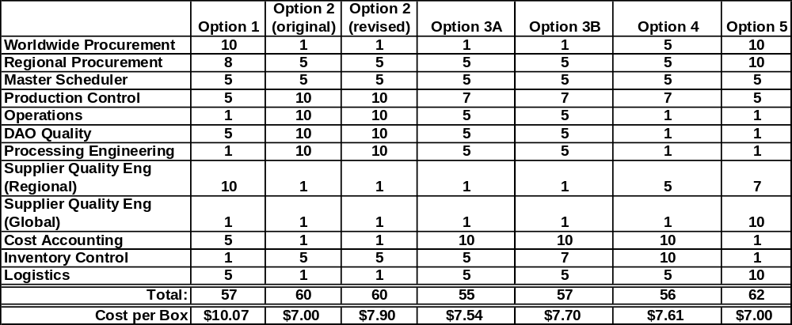
Complexity Analysis
Legend:
The “Cost per Box” data has been modified to respect Dell’s data confidentiality.
Option 1: EM-managed 3PI Option 2: Integration at DAO work cells
Option 3A: Integration at SLC/hub Option 3B: Integration at Dell-leased bldg
Option 4: Dell-managed 3PI Option 5: Integrated chassis from Mexico

Slide 38
Which is best?
Least complexity
  Option 3A
Lowest cost
  Option 2
Final choice
  Option 4

Slide 39
Lessons Learned
Supply chain coordination requires involvement from all partners in the chain (customer, supplier, sub-tier suppliers).
Qualitative judgment is just as important as or more critical than quantitative analysis.

